Slide 1

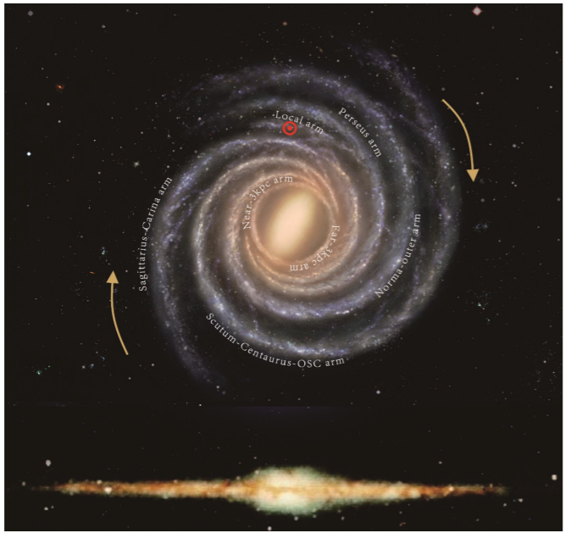
Revisiting the Oort Constants Measurement from Simulation and Gaia DR2 Observations
Shufan Xia
Advised by Prof. Karen Masters (Haverford)
& Dr. Zhao-yu Li
(Shanghai Jiaotong University)

Slide 2
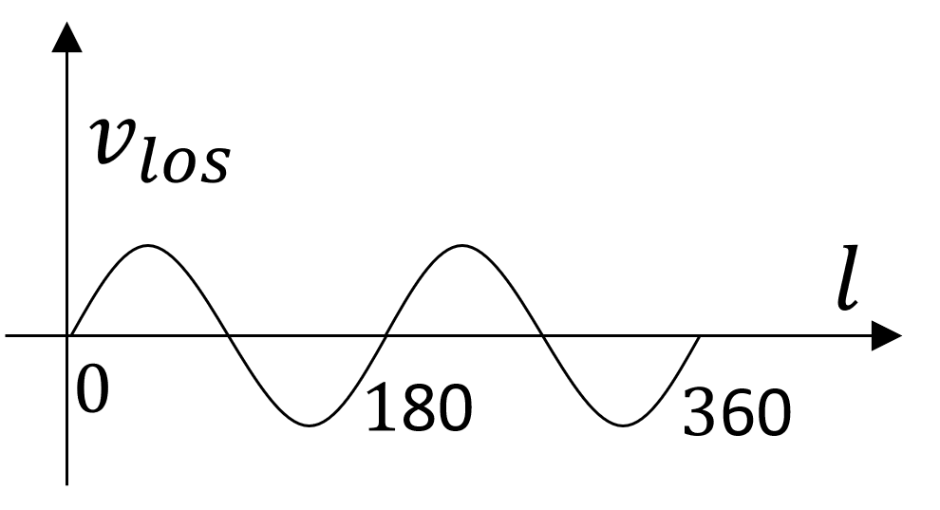
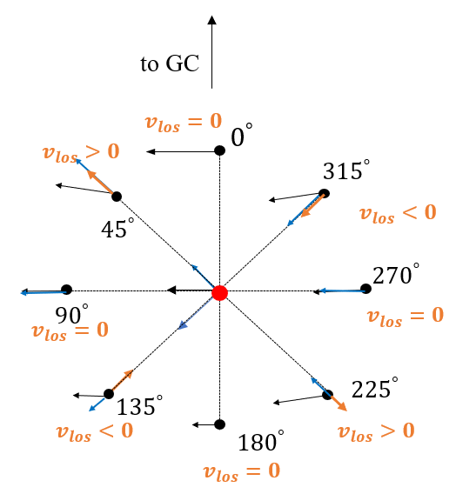
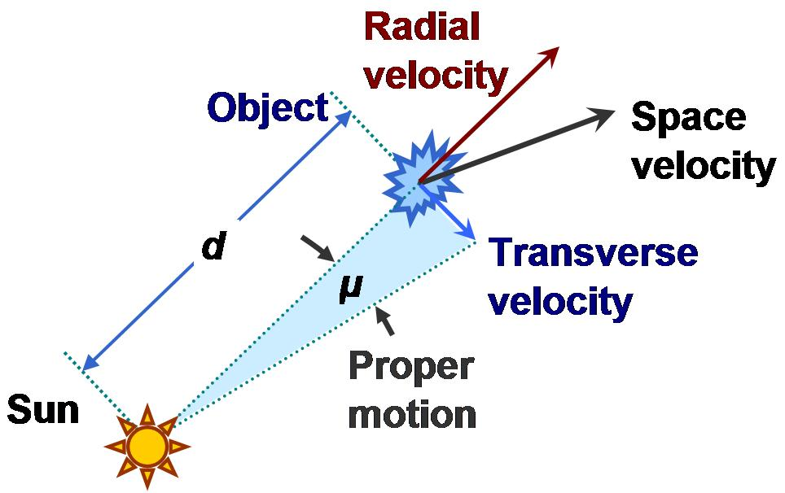
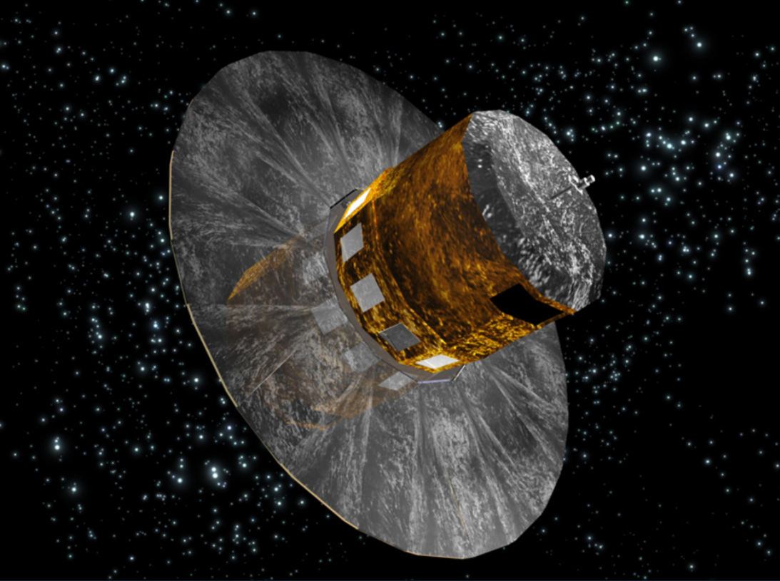
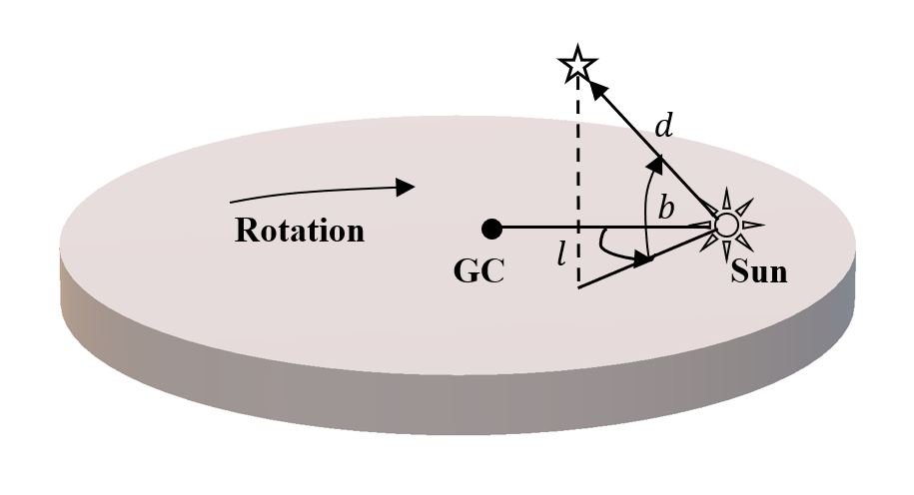
The Oort constants are local tracers of the Milky Way Kinematics
Galactic coordinate
$$μ_{l}=\left(A cos2l−Csin2l+B\right)cosb+\text{terms} \text{to} \text{correct} \text{solar} \text{peculiar} \text{motion}$$
$μ_{b}=−\left(A sin2l+Ccos2l+K\right)sinbcosb+$terms to correct solar peculiar motion
$v_{los}=d\left(A sin2l+Ccos2l+K\right)+$terms to correct solar peculiar motion
Oort constants, A, B, C, K describe the local velocity field.
Slope of rotation velocity, rotation frequency and slope of radial velocity can be expressed in terms of them.
We use toy model simulation and analyze Gaia DR2 data to find the best subsets of stars to derive the Oort constants.

Slide 3
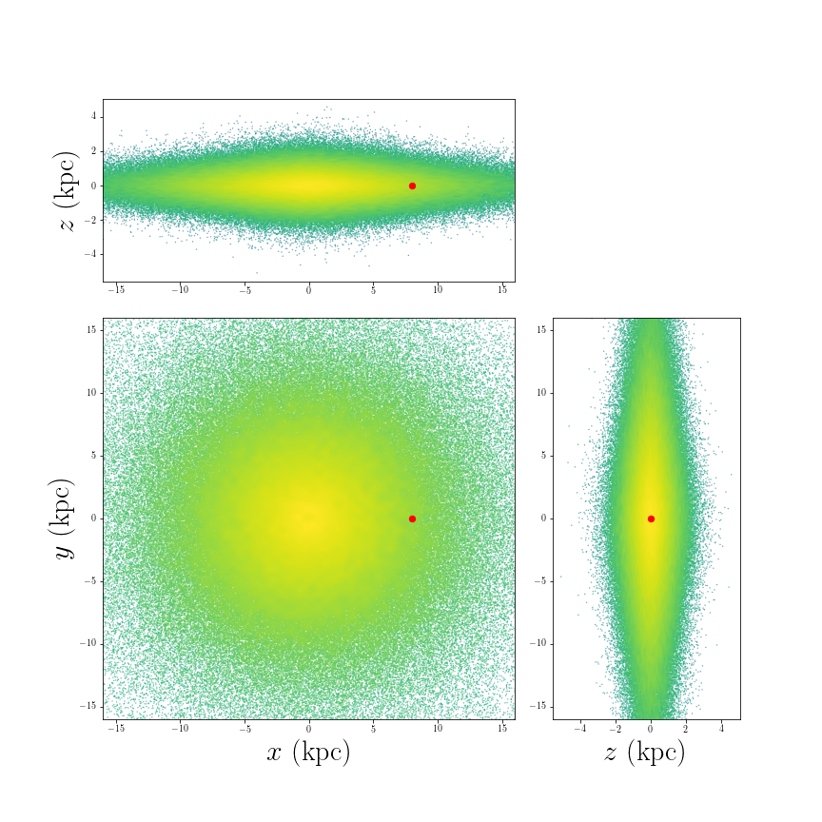
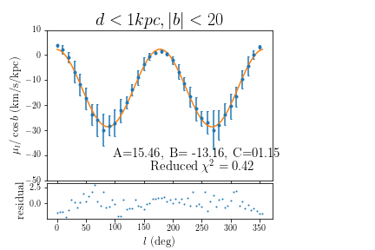
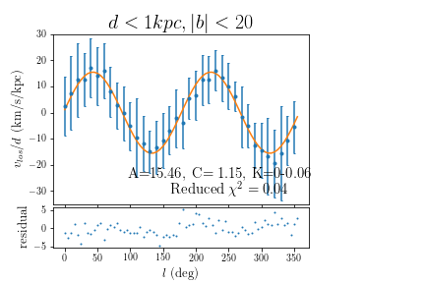
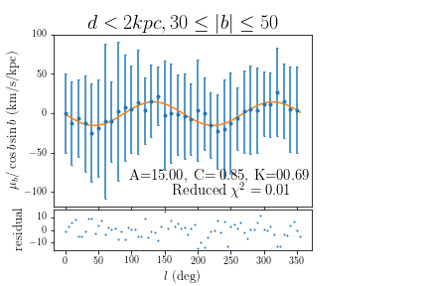
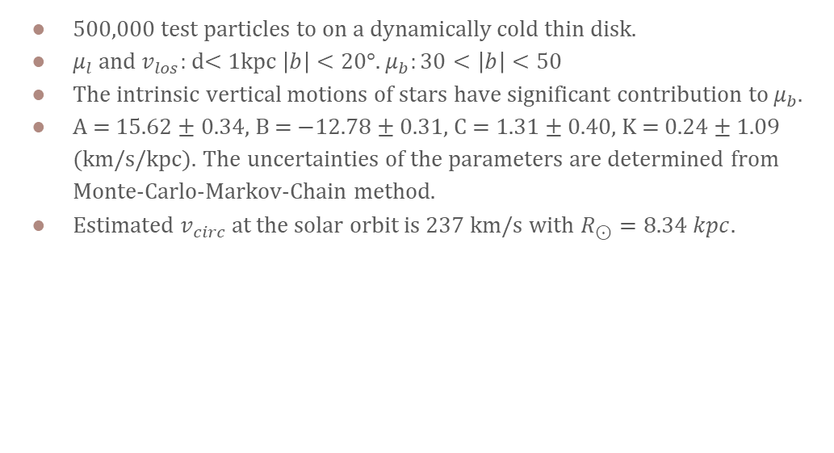
Toy Model Simulation
500,000 test particles to on a dynamically cold thin disk.
$μ_{l}$ and $v_{los}:$ d< 1kpc $\left|b\right|<20°$. $μ_{b}:30<\left|b\right|<50$
The intrinsic vertical motions of stars have significant contribution to $μ_{b}$.
A = 15.62 ± 0.34, B = −12.78 ± 0.31, C = 1.31 ± 0.40, K = 0.24 ± 1.09 (km/s/kpc). The uncertainties of the parameters are determined from Monte-Carlo-Markov-Chain method.
Estimated $v_{circ}$at the solar orbit is 237 km/s with $R_{⊙}=8.34 kpc$.

Slide 4
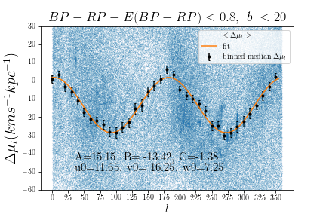
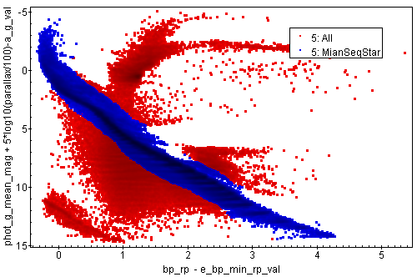
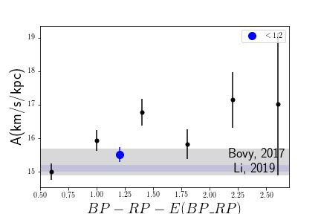
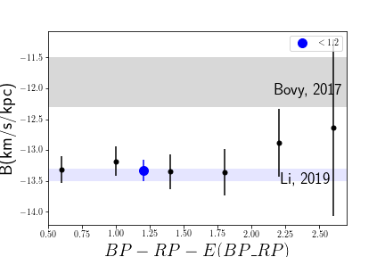
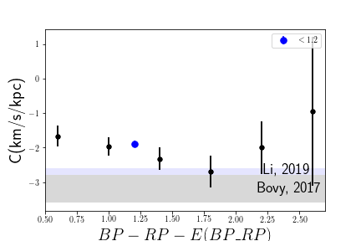
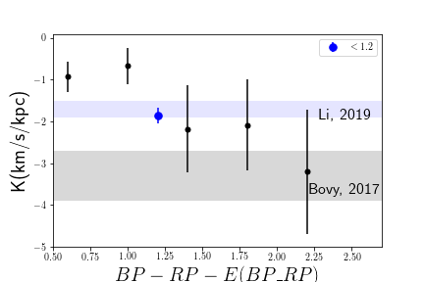
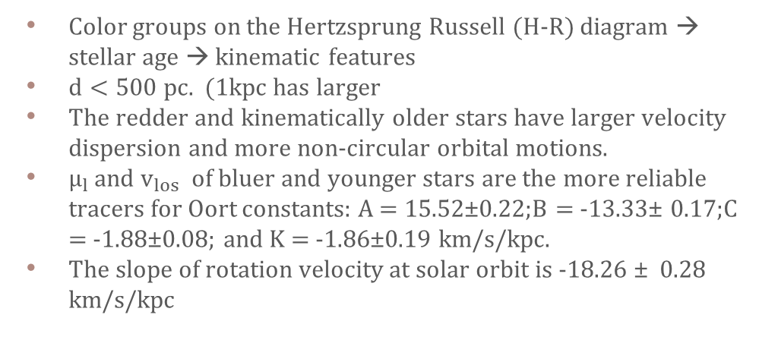
Gaia DR2: Main sequence stars
Color groups on the Hertzsprung Russell (H-R) diagram → stellar age → kinematic features
$d<500 pc.$ (1kpc has larger
The redder and kinematically older stars have larger velocity dispersion and more non-circular orbital motions.
$μ_{l}$ and $v_{los}$ of bluer and younger stars are the more reliable tracers for Oort constants: A = 15.52±0.22;B = -13.33± 0.17;C = -1.88±0.08; and K = -1.86±0.19 km/s/kpc.
The slope of rotation velocity at solar orbit is -18.26 ± 0.28 km/s/kpc

Slide 5

Acknowledgement
Prof. Karen Masters
Dr. Zhaoyu Li and Dr. Juntai Shen from Shanghaijiaotong University
This work has made use of data from the European Space Agency (ESA) mission Gaia (https://www.cosmos.esa.int/gaia ), processed by the Gaia Data Processing and Analysis Consortium (DPAC, https://www.cosmos.esa.int/web/gaia/dpac/consortium ). Funding for the DPAC has been provided by national institutions, in particular the institutions participating in the Gaia Multilateral Agreement.

Slide 6
Sources
Artist’s impression of Gaia:European Space Agenecy, https://www.esa.int/ESA_Multimedia/Images/2006/05/Artist_s_impression_of_the_Gaia_satellite
Rotation curve: Eilers, A.-C., Hogg, D. W., Rix, H.-W., & Ness, M. K.2019, ApJ, 871, 120, doi: 10.3847/1538-4357/aaf648
Proper motion: Wikipedia – proper motion
Longitude proper motion: Li, C., Zhao, G., & Yang, C. 2019, ApJ, 872, 205, doi: 10.3847/1538-4357/ab0104
Bovy, J. 2017, MNRAS, 468, L63, doi: 10.1093/mnrasl/slx027

Slide 7
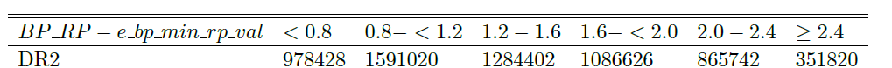
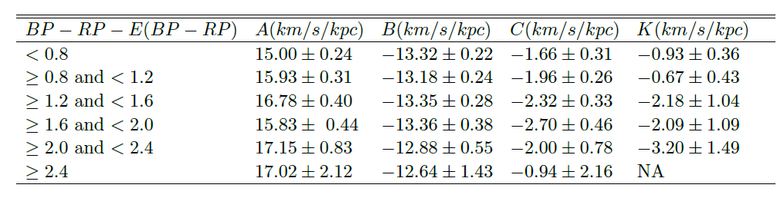
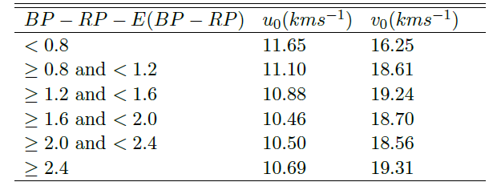
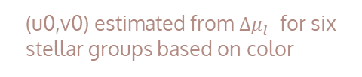
Gaia DR2
Number of main sequence stars fall into each color group for DR2 and EDR3.
(u0,v0) estimated from ${Δμ}_{l}$ for six stellar groups based on color
Oort constants for six stellar groups based on color

Slide 8
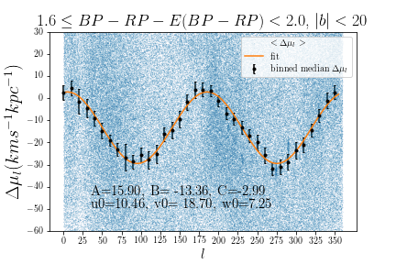
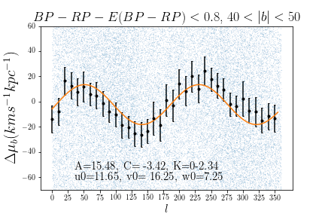
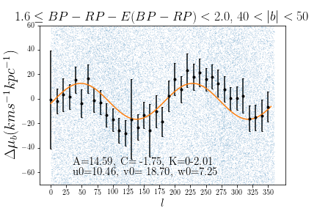
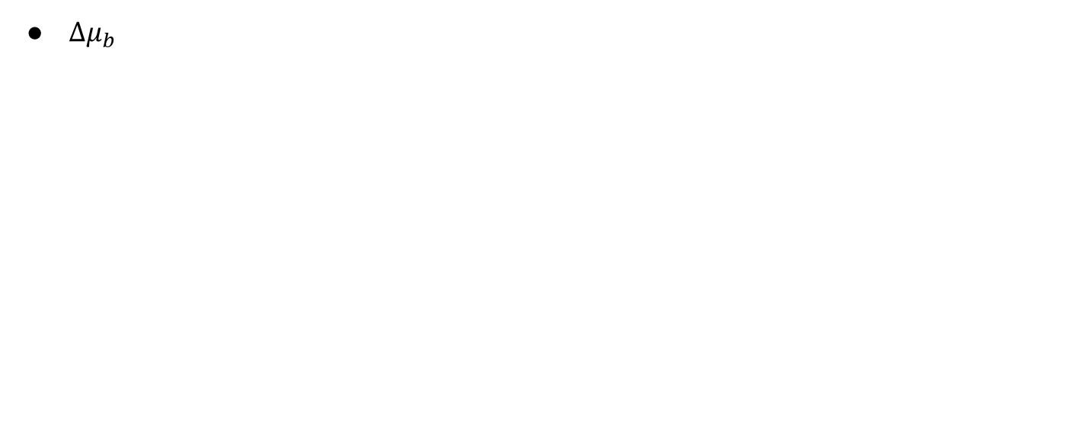
DR2 observations
$Δμ_{b}$
DR2 data confirms the Oort constants model
The error bars and deviations from the model suggests that redder and kinematically older stars have larger velocity dispersion and more non-circular orbital motion.

Slide 9
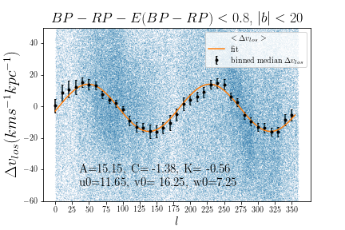
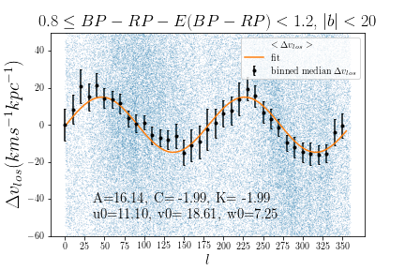
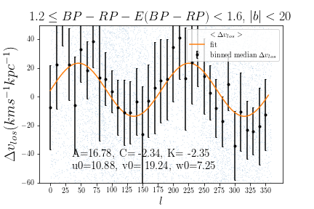
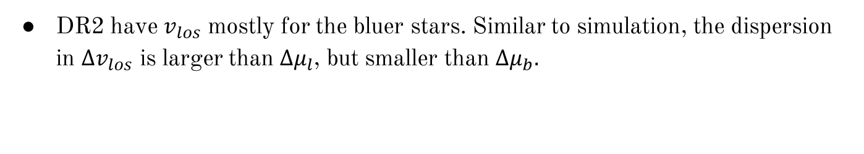
DR2 observations
DR2 have $v_{los}$ mostly for the bluer stars. Similar to simulation, the dispersion in $∆v_{los}$ is larger than ${∆μ}_{l}$, but smaller than ${∆μ}_{b}.$

Slide 10
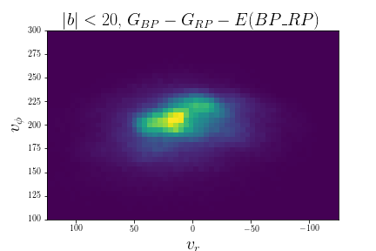
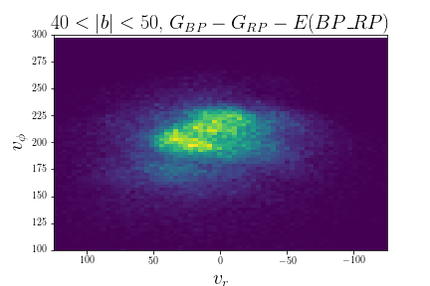
Gaia DR2 phase plot

Slide 11
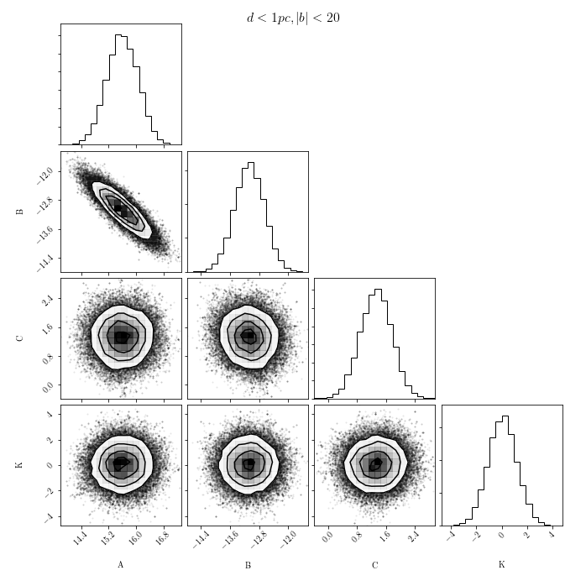
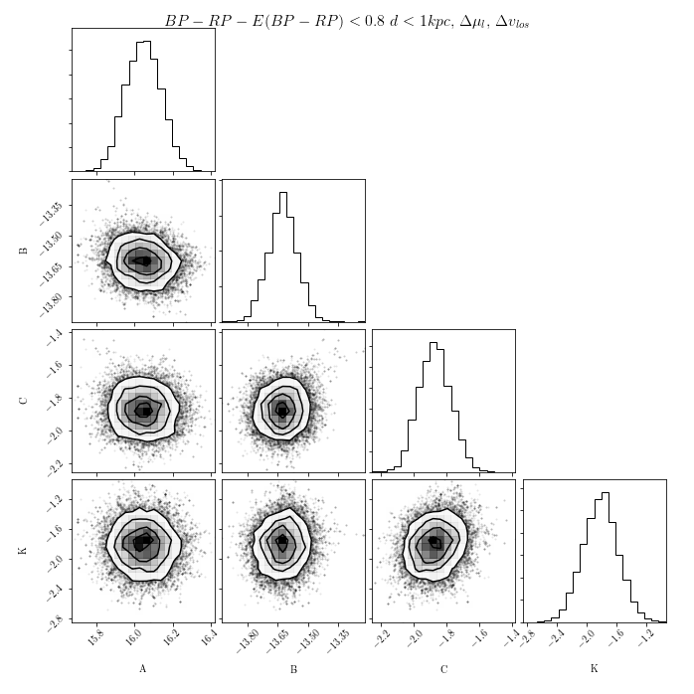
MCMC Corner Plots
Simulation
Gaia DR2

